Slide 1




Global Classroom (ITA & TEC)

Slide 2
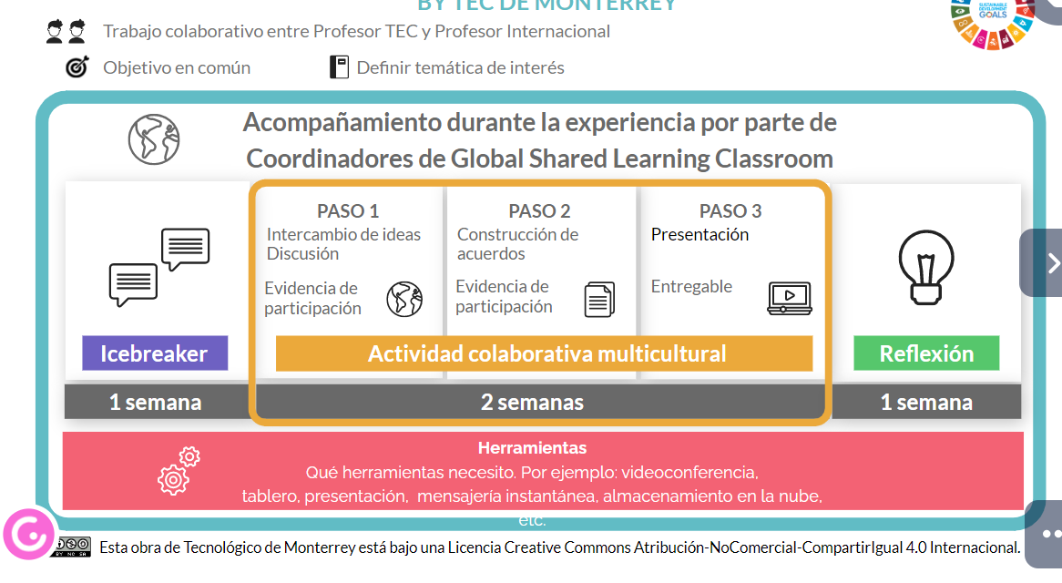

Slide 3
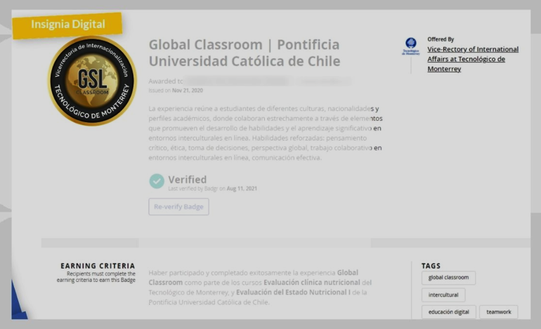
Digital Badge
Tecnológico de Monterrey awards a digital badge to students who participate in the Global Classroom experience when they have met the following criteria:
Participation in the icebreaker.
Participation in Team Activities.
Participation in the Reflection.
Obtain 80% of the total of the Global Classroom grade.
In the end, students will receive an e-mail with their digital badge and another to answer a survey that aims to improve the Global Classroom experience continuously.

Slide 4
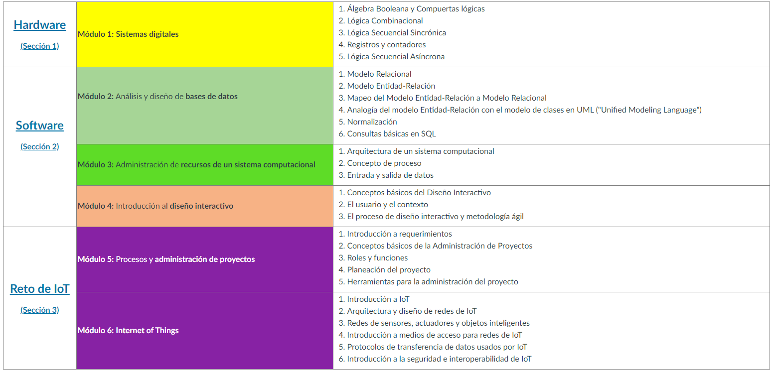
TC1004B – Internet of Things

Slide 5
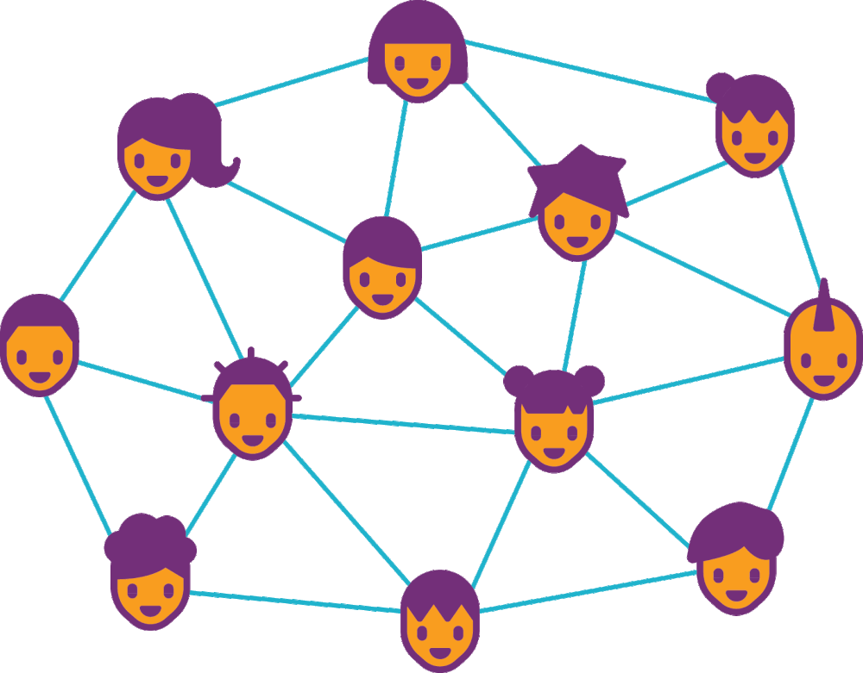
ITA – Network

Slide 6
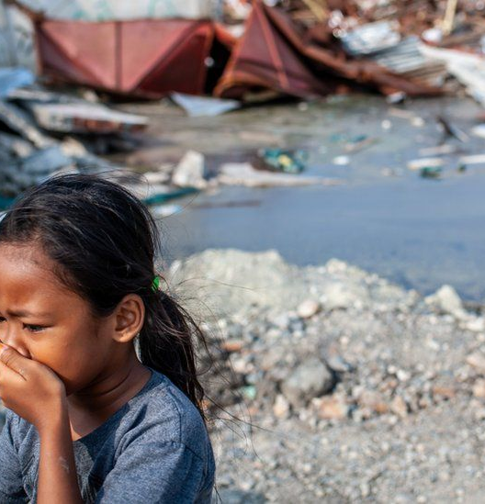
Goal of Collaboration
The collaboration focuses on developing the students the sense of cooperation needed to solve a complex problem.
The problem to be answered is how to provide an efficient and secure environment to send a distress message when a natural disaster occurs (earthquake, flood, etc.).

Slide 7
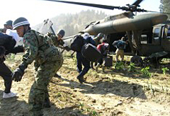
SDG’s goals
The sustainable development goal is the “Industry, Innovation, and Infrastructure” and “Sustainable Cities and Communities,” where the group will work to build a resilient infrastructure when there is a natural hazard.

Slide 8
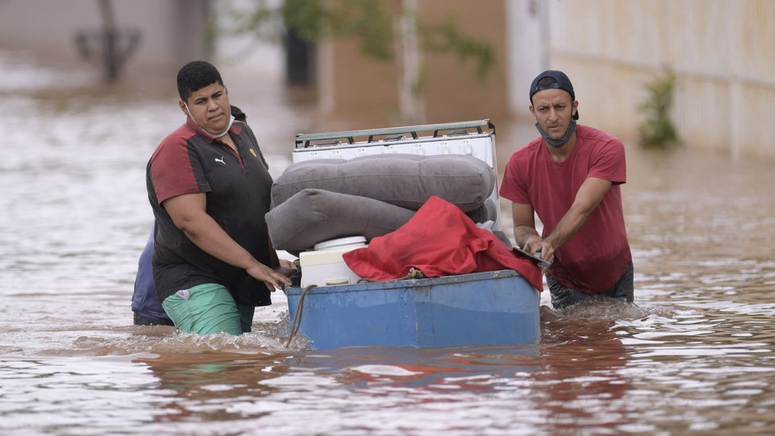
Scenario - Flood
Drones Operations
No Telecommunications
Raspberry Devices
OR
Android
No C2 Resources

Slide 9





Flood Scenario
Location
Risk
Severity
Edge
MQQT/REST
MQQT/REST
Cloud
MQQT
MQQT
MQQT
GPS Position
Severity
GPS Position
Severity
Sensors

Slide 10





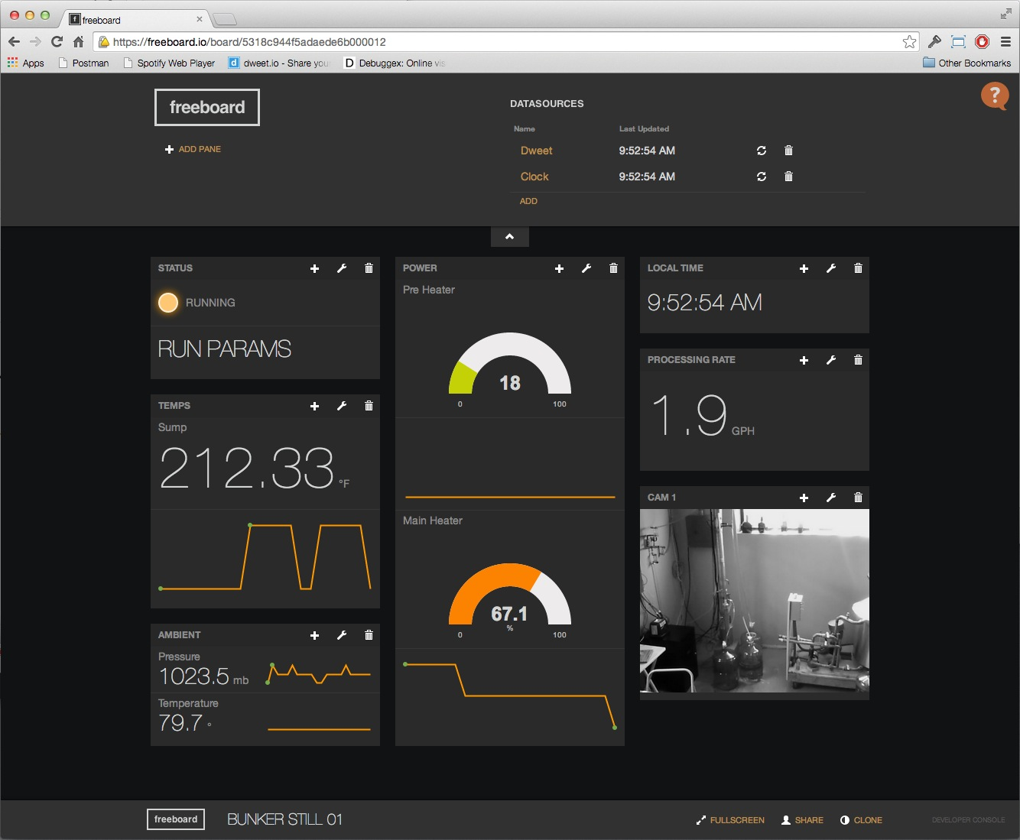
Cloud
Edge
Location
Risk
Severity
GPS Position
Severity
GPS Position
Severity
Sensors

Slide 11

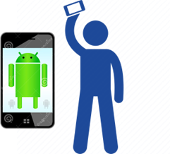

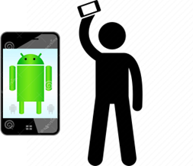



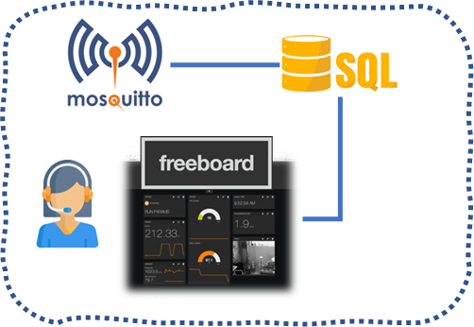
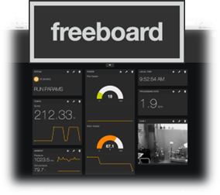
Legend
Emulated user node
Real node (Android)
Real MQTT Broker – Bridge Mode
Emulated Interface (Mininet)
Emulated Wireless Environment(Mininet)
Real Application Server

Slide 12
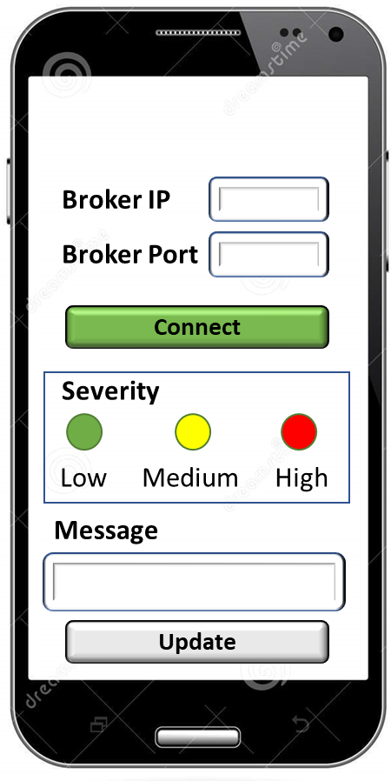


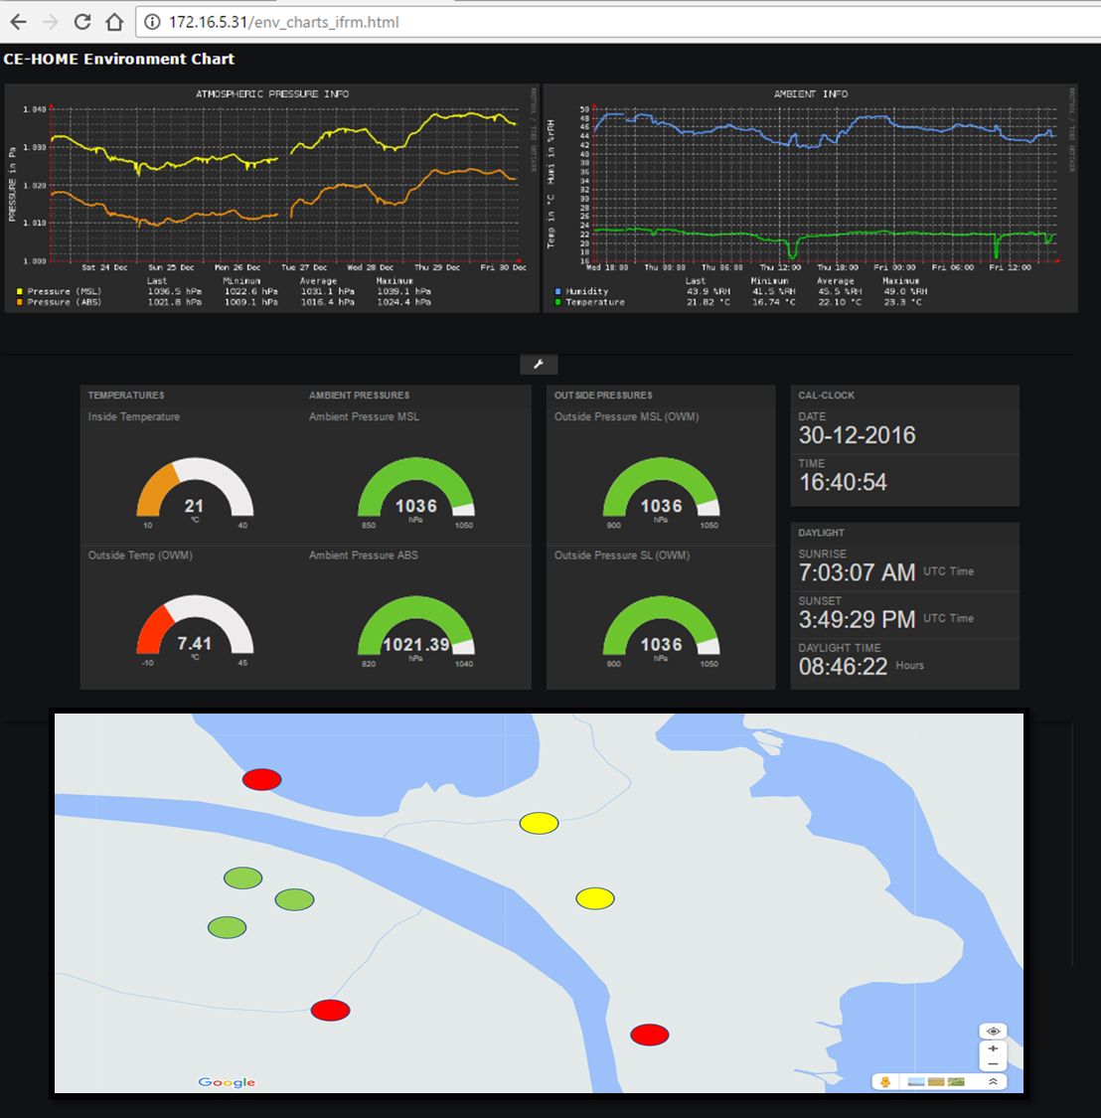

1
1
Emulation Gateway
CLOUD STAGE
EDGE & GATEWAY STAGE
Internet Gateway
SENSORS AND ACTUATORS STAGE
real MQTT device flow
emulated MQTT device flow

Slide 13
1
2
CLOUD STAGE
3

Slide 14
mqtt_publish(srv/rescue)
2
1
3
mqtt_publish(srv/rescue)
mqtt_subscribe (srv/rescue)
SQL INSERT (srv/rescue)
4
subscribe_server.py

Slide 15
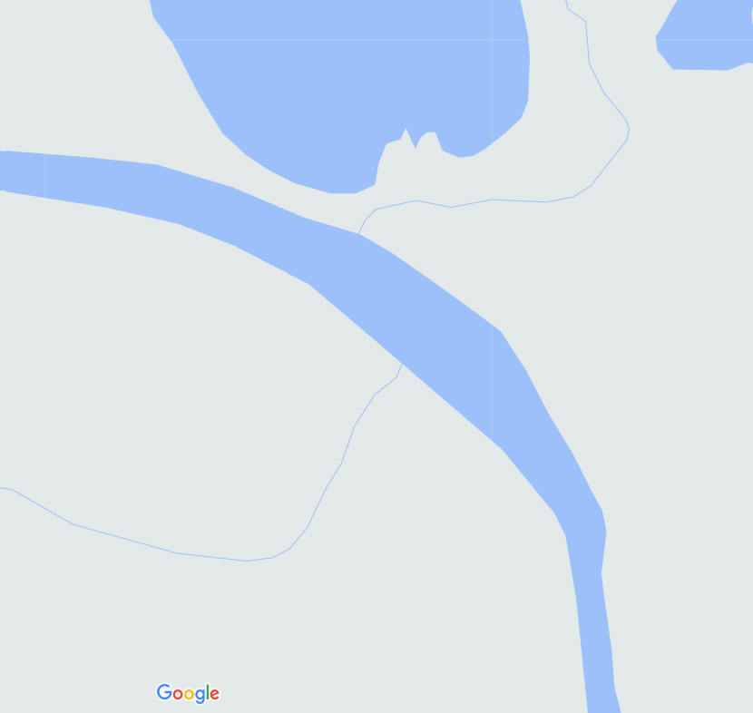
Low
Middle
High
Severity
(SEV)
Low
SEV eq Low
Risk
Middle
SEV eq Middle && t_{SEV} < 10 min
SEV eq High
SEV eq Middle && t_{SEV} >20 min
High

Slide 16
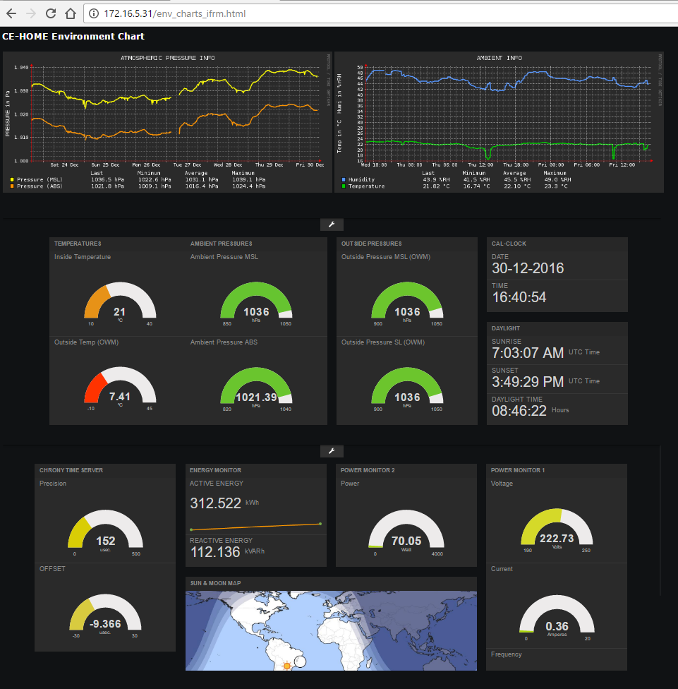
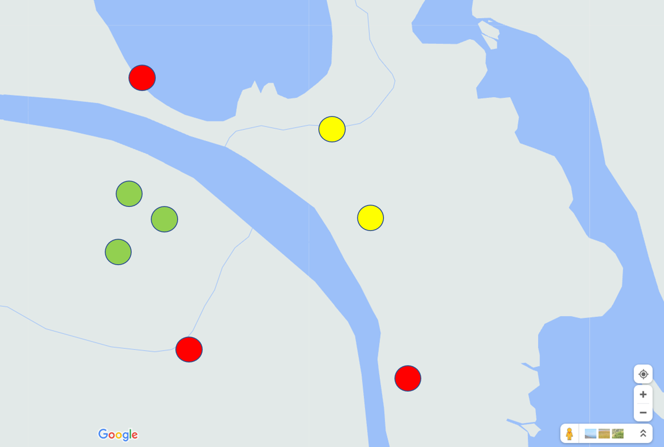

Slide 17
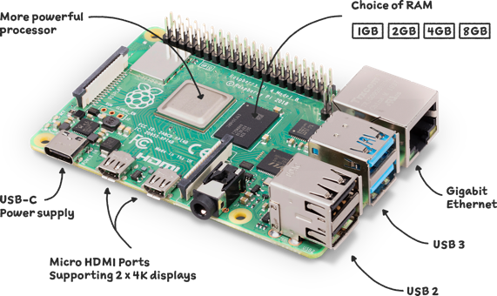
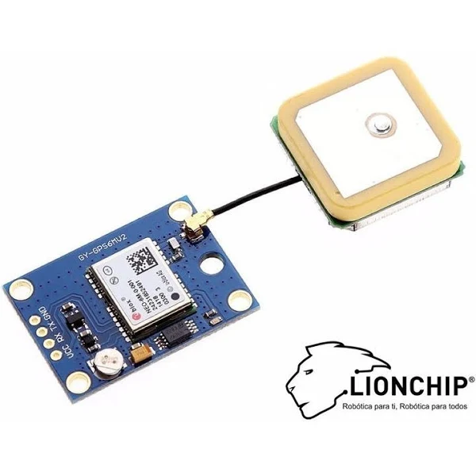
Raspberry Device
Raspberry Pi 4
Modulo Gps Arduino Ublox Neo-6m Raspberry Antena 6m Neo Pic

Slide 18

Android App
Broker IP
Broker Port
Connect
Severity
Low
Medium
High
Update

Slide 19
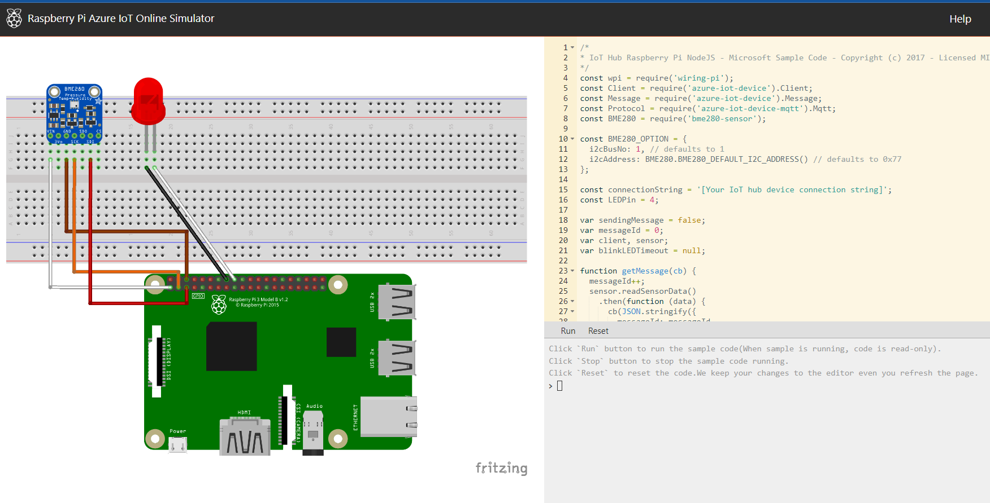
Raspberry Device
https://azure-samples.github.io/raspberry-pi-web-simulator/

Slide 20
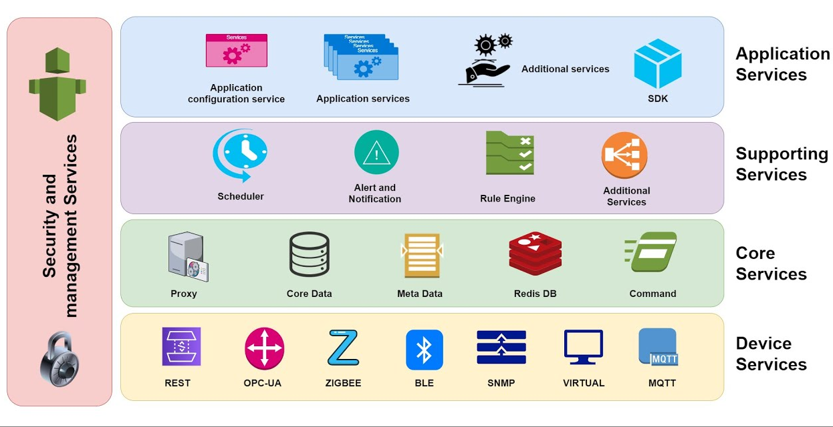

Edge IT
https://www.edgexfoundry.org/

Slide 21
Cloud
Risk
Severity High
Severity Middle && >10 min
Low
Middle
High
Severity

Slide 22
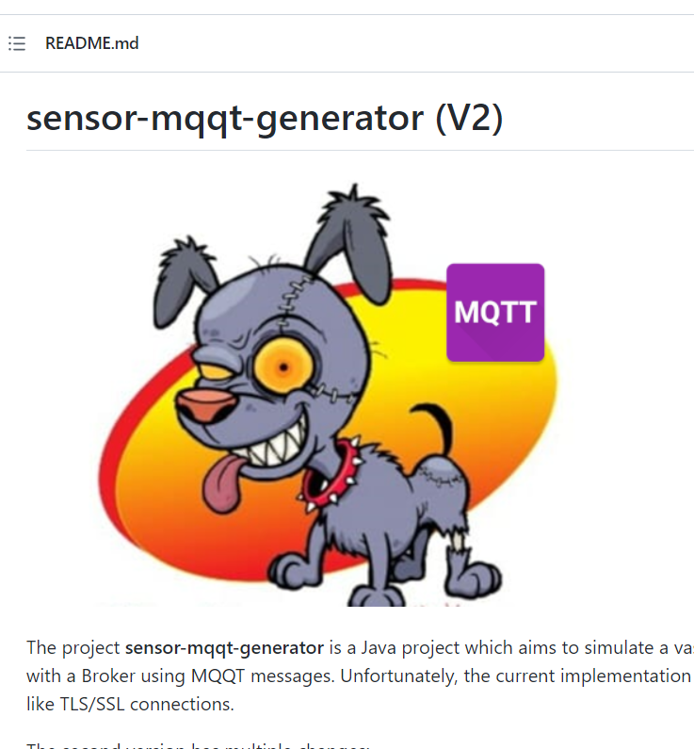
MQQT Simulator (Devices)
https://github.com/kabartsjc/sensor-mqqt-generator
https://azure-samples.github.io/raspberry-pi-web-simulator/

Slide 23
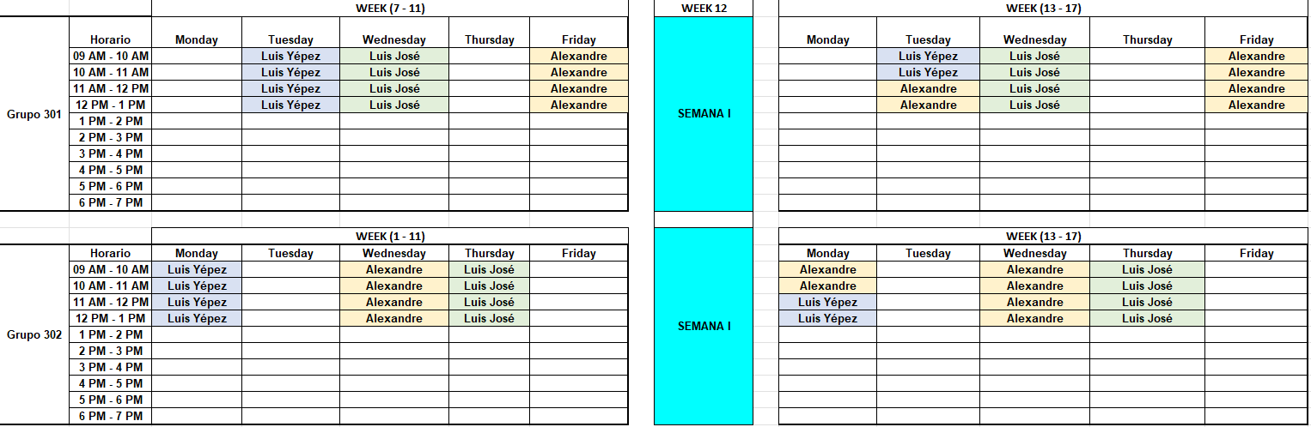
Course Organization

Slide 24
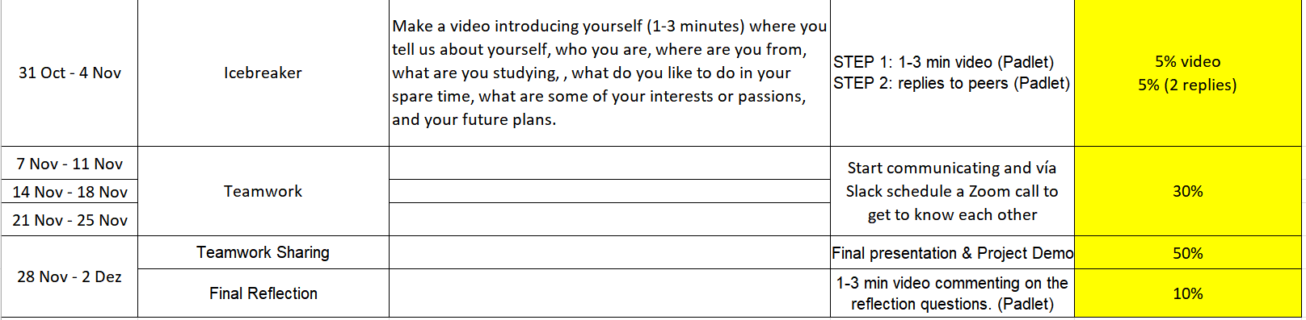
Course Organization

Slide 25

Final Remarks
How many students (number of devices)?
GPS sensors??
Course Organization

Slide 26
Global Classroom (ITA & TEC)

